Slide 1
Verification mehtods for vlsi design
Masrur jamil prochchhod
Id-2210028

Slide 2
introduction
What is VLSI Design?
VLSI (Very Large Scale Integration) involves designing integrated circuits by combining thousands to millions of transistors into a single chip.
It is a key enabler of compact, high-performance, and energy-efficient electronic devices
Importance of Verification in VLSI
Ensures functionality, performance, and reliability of complex VLSI designs before fabrication.
Plays a critical role in detecting and addressing errors early in the design process, reducing costs and time-to-market.

Slide 3
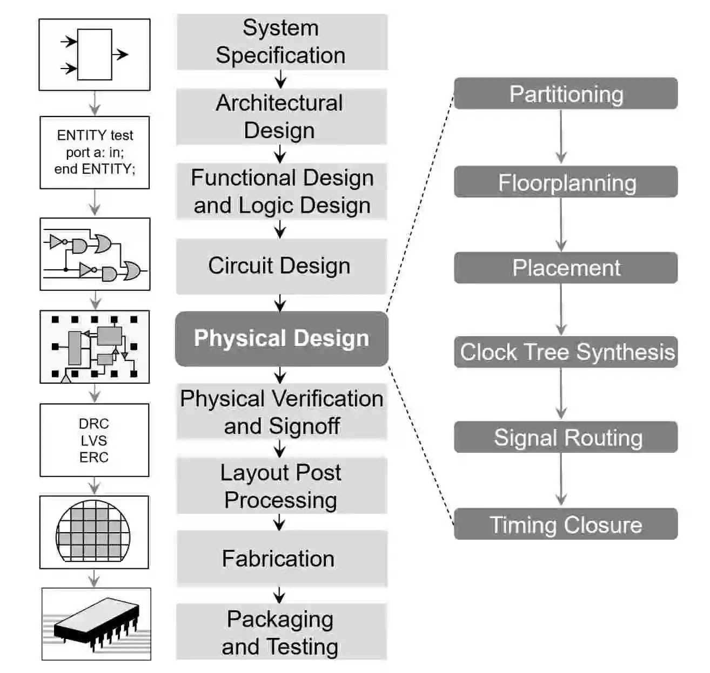
Overview of vlsi design flow
System Specification
Architectural Design
Function and Logic Design
Circuit Design
Physical Design
Physical Verification
Fabrication
Packaging and Testing
1

Slide 4
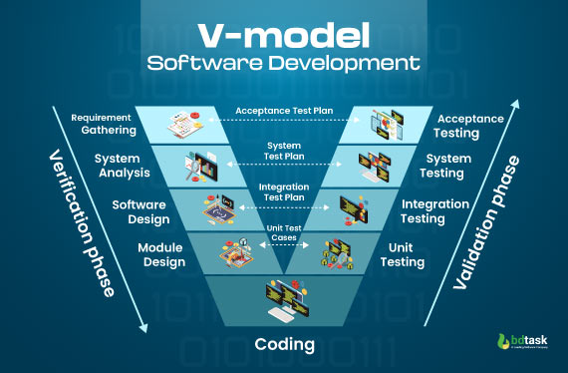
V Model
2

Slide 5
Verification methodologies in vlsi design
Simulation Based Verification
Formal Verification
Emulation Based Verification
Static Verification
Post-Silicon Verification

Slide 6
Industry Standards in Verification
IEEE 1800 (System Verilog)
Universal Verification Methodology (UVM)

Slide 7
Verification Analysis and Key Metrics in VLSI Design
Code Coverage
Functional Coverage
Timing Analysis

Slide 8
Impact of Verification on Design Quality and Efficiency
Cost Savings
Product Reliability
Time to time market

Slide 9
Summary
Verification ensures that VLSI circuits function correctly, meet performance standards, and adhere to power, timing, and area constraints.
V Model provides a structured and systematic approach to verification.
Standards like IEEE 1800 (SystemVerilog) and UVM enable scalable and reusable verification workflows.
Verification ensures manufacturable, reliable, and efficient designs.

Slide 10
References
https://www.themechatronicsblog.com/2023/04/vlsi-design-%20a-complete-overview-of-the-vlsi-design-flow.html
https://www.bdtask.com/blog/v-model-in-software-development
https://www.researchgate.net/publication/234290920_Verification_of_VLSI_designs
ieeexplore.ieee.org/document/5390530
www.design-reuse.com/articles/54702/importance-of-vlsi-design-verification-and-its-methodologies.html
internationalpubls.com/index.php/anvi/article/view/1444

